Slide 1
System Development Methods CT00046-3-2
Agile Methodologies

Slide 2
Topic & Structure of the Lesson
Understanding Agile Projects
Agile Principles

Slide 3
Learning Outcomes
By the end of this lecture, YOU should be able to :
Identify and explain the underlying principles for systems Agile methods

Slide 4
Key Terms you must be able to use
If you have mastered this topic, you should be able to use the following terms correctly in your assignments and exams:
Agile Methods
Agile Principles

Slide 5

Modern IS Methodologies
Developed in the mid 80’s
Focus on fast delivery of software and customer satisfaction.
Traditional Methodologies focus on product excellence and documentation.
Flexible stages
Most Methodologies adopt Agile Principles.
Example of modern methodologies;
RAD
XP
Scrum

Slide 6
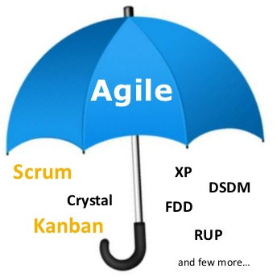
Agile Methods
Agile Methods are a set of Modern IS Methodologies which shares some of the Agile Principles.
Agile Principles are defined in ‘The Agile Manifesto’, developed by expect software developers in 2001.
Agility (in a software development sense) means;
Being flexible.
Being in control.
Able to adapt to changing environment.

Slide 7

The Agile Manifesto is based on twelve principles
Customer satisfaction by early and continuous delivery of valuable software
Welcome changing requirements, even in late development
Working software is delivered frequently (weeks rather than months)
Close, daily cooperation between business people and developers
Projects are built around motivated individuals, who should be trusted
Face-to-face conversation is the best form of communication (co-location)
Working software is the principal measure of progress
Sustainable development, able to maintain a constant pace
Continuous attention to technical excellence and good design
Simplicity—the art of maximizing the amount of work not done—is essential
Best architectures, requirements, and designs emerge from self-organizing teams
Regularly, the team reflects on how to become more effective, and adjusts accordingly
* See next slide for summarized version

Slide 8

Agile Principles (summarized version)
Customer Satisfaction
By fast and frequent delivery of products
Welcome changing requirements, even late in development
Teamwork
By Face-to-face communication with all people involved
Motivate and trust developers
Fast Development
Break bigger system into small and manageable components
Close monitoring of development
High Product Quality
Maintain good design and simplicity
Adopt to latest technologies.

Slide 9
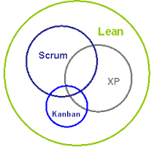
Popular IS Methodologies under adopting to Agile Principles
Extreme Programming (XP).
Scrum Agile Modeling Adaptive Software Development (ASD).
Dynamic Systems Development Method (DSDM).
Feature Driven Development (FDD).
Lean software development.
Dialogue-Driven Development (aka d3).
Kanban Methods
Most of the above Methodologies share most (or all) of the Agile Principles.
Agile

Slide 10
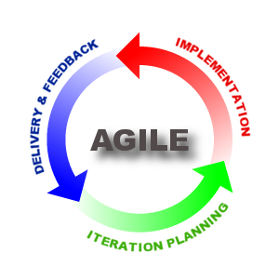
Advantages of Agile Methods
Customer satisfaction with frequent delivery of working product.
Gives customers/users ‘power’ to change their mind anytime and send new requirements.
Gives more ‘control’ to core developers to make decisions
Emphasize the use of latest design and technologies
Encourage close communication and teamwork.

Slide 11
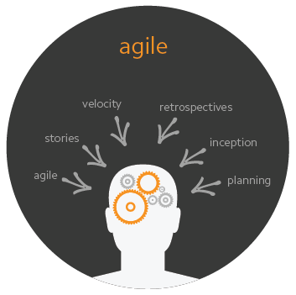
Disadvantages of Agile Methods
Users/customers not available at all time.
Developer - difficult to determine final cost and development time as requirement keep changing
Developer – difficult to plan and deliver workable product frequently.
Experts developers and CASE Tools are expensive
Often lack comprehensive documentation

Slide 12
Quick Quiz
Briefly explain the following techniques;
Iterative and Incremental approach

Slide 13
Question & Answer

Slide 14
Next Session
Process Oriented Methodologies

Slide 15
Tutorial
List down and briefly explain the 12 principles of Agile Methods.
Compare Traditional methodologies with Agile Principles
Give examples of projects where Agile Methods would NOT be suitable to be used (compared to Structured Methods).
Discuss the weakness of Agile Methods.

